Slide 1
Linux Part II: Using Biocluster
(http://facility.bioinformatics.ucr.edu/home/workshops)
Instructor: Jordan Hayes

Slide 2
Linux Part II: Using Biocluster
Storage
Module System
Environment Variables
Scripting
Queuing System
Screen / Tmux
Helpful Resources

Slide 3
Storage
Home is used for scripting, debugging and small files.
/rhome/username
Bigdata is used for parallel jobs, high read/write operations (load) and big files.
/bigdata/labname/username
/bigdata/labname/shared
Note: All lab members share the same bigdata pool.
Total = /bigdata/labname/shared + /bigdata/labname/labmember1 + /bigdata/labname/labmember2 + /bigdata/labname/labmemberX
https://dashboard.bioinfo.ucr.edu
Scratch is used for quick access and only temporary (30 days max).

Slide 4
Software Module System
Print available modules module avail
Print available modules starting with R module avail R
Load default module R module load R
Load specific module R version module load R/3.2.0
Print list of loaded modules module list
Unload module R
module unload R
Unload specific module R
module unload R/3.2.0
Notes:
Some notes are in here

Slide 5
Environment Variables
Biocluster uses bash as the default shell environment.
Within this environment, variables can be set and reused.
MYVAR=’Something’
export MYVAR=’Something’
echo $MYVAR
Some software utilizes this feature and requires that specific environment variables be set.
$HOME #Contains your home path
$USER #Contains your username
$PATH #Contains paths of executables
$LD_LIBRARY_PATH #Contains paths of dependencies
Torque (PBS)
$PBS_O_WORKDIR #And many more
Notes:
Some notes are in here

Slide 6
Scripting
Converting code into a script is useful.
Easy to run - blackbox
Easy to maintain - consolidated code
Easy to distribute - capsulated code
Easy to automate (crontab?) - does not require interaction
Notes:
Some notes are in here

Slide 7
Scripting
#! (SheBang) - First line in file which defines the interpreter
#!/bin/bash
Permissions - At least the owner of the file requires execute permissions
chmod u+x myscript.sh
Pass arguments via command line - Makes script reusable
myscript.sh prot.fasta 2
Add to PATH - Makes script callable by name and without path
export PATH=~/bin:$PATH #add to .bashrc
Notes:
Some notes are in here

Slide 8
Scripting
Bash commands:
cd ~/mywork
module load ncbi-blast
module load db-ncbi
blastp -query prot.faa -db $NCBI_DB/nr -out prot.txt -num_threads 2

Slide 9
Scripting
Example: myscript.sh prot.fasta 2
#!/bin/bash -l
# Load modules
module load ncbi-blast
module load db-ncbi
# Change directory
cd ~/mywork
# Run BLAST
blastp -query $1 -db $NCBI_DB/nr -out $1.txt -num_threads $2

Slide 10
Queuing System
Biocluster
Torque & Maui
Biocluster Nodes
(compute cloud)
biocluster (headnode)

Slide 11
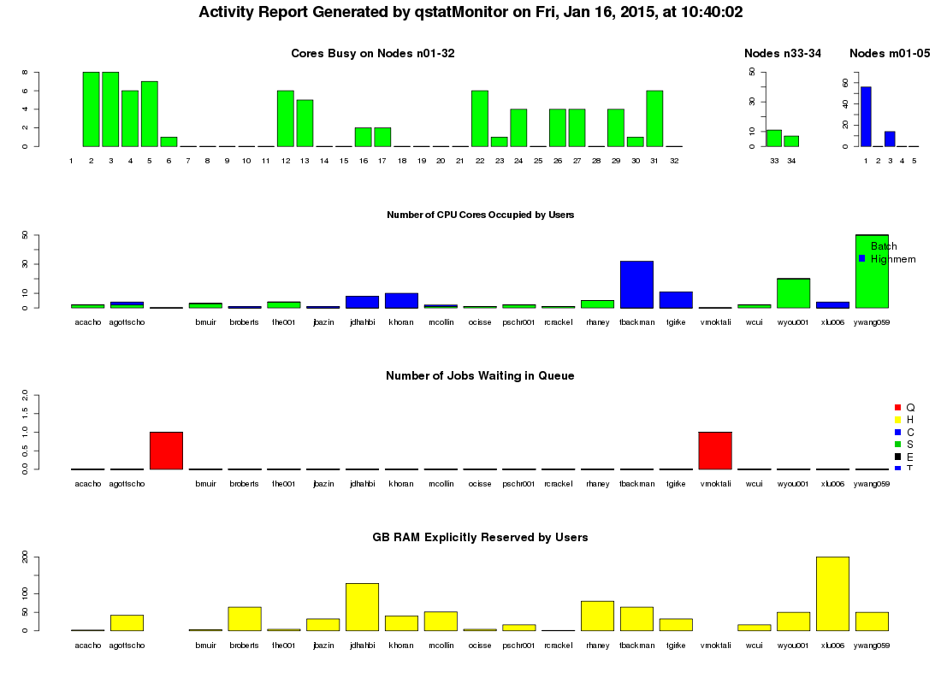
Queuing System
Torque (PBS)
Load Balancing
Parallel Computing
Maui
Resource Management
Job Scheduler
Current status can be viewed from here.
highmem
batch

Slide 12
Queuing System
Check how busy the queue is overall (CPU, memory, walltime, etc...):
showbf -S | less #press ‘q’ to quit
Check how many processors are immediately available per walltime window on the batch queue:
showbf -f batch
Check earliest start and completion times (should not be infinity):
showstart JOBID
Check if a job is held:
showhold | grep JOBID
Check status of job and display reason for failure (if applicable):
checkjob JOBID

Slide 13
Queuing System
qsub
Basic job submission
echo ‘myscript.sh prot.faa 2’ | qsub
qsub -F ‘prot.faa 2’ myscript.sh
Additional arguments (man qsub)
-I
-q highmem
-l nodes=1:ppn=2,mem=50gb,walltime=03:00:00
-N JobName
-M your@email.com -m abe
STDOUT files
SCRIPTNAME.sh.oJOBID OR STDIN.oJOBID
SCRIPTNAME.sh.eJOBID OR STDIN.eJOBID

Slide 14
Queuing System
qsub
Default Resources
batch (256 cores MAX)
mem=1G
nodes=1
ppn=1
walltime=168:00:00
highmem (32 cores MAX)
mem=16G
nodes=1
ppn=1
walltime=48:00:00
Note: Each user has a 256 core total maximum. Each lab has a 512 core total maximum.

Slide 15
Queuing System
qsub advanced
Array job submission
qsub -t 1-100 myscript.sh
Dependency submission (man qsub)
qsub -W depend=afterok:JOBID myscript.sh qsub -W depend=before:JOBID myscript.sh
Multi-threaded submission
qsub -l nodes=1:ppn=8 myscript.sh
OpenMPI submission (TBA)
qsub -l nodes=2:ppn=8 myscript.sh

Slide 16
Queuing System
#!/bin/bash -l
#PBS -t 1-2
# Load modules
module load ncbi-blast
module load db-ncbi
# Change directory using PBS environment variable
cd $PBS_O_WORKDIR
# Run BLAST
blastp -query $PBS_ARRAYID.$1 -db $NCBI_DB/nr -out $PBS_ARRAYID.$1.txt -num_threads $2

Slide 17
Queuing System
qstat
View your current jobs and their status
qstat -u jhayes
Job ID Username Queue Jobname Req'd Time S Elap Time
----------------- --------- -------- -------- ... ----------- - ----------
900001.torque01 jhayes batch example1 168:00:0 R 164:04:2
900002.torque01 jhayes highmem myscript.sh 03:00:00 R 01:52:2
900003.torque01 jhayes batch example2 -- Q --
900004.torque01 jhayes highmem example3 -- H --
More detailed information (node information and expanded array jobs)
qstat -nt1 -u jhayes

Slide 18
Queuing System
qdel
Remove job from queuing system
qdel JOBID
Remove entire array job from queuing system
qdel JOBID[]
Remove job from array in queuing system
qdel JOBID[ARRAYID]

Slide 19
Screen / Tmux
Screen and Tmux are tools that allow you to manage multiple persistent login sessions. Mainly utilized for scripting and debugging.
DOs
Continue running session even if connection is lost
Reconnect from a different machine
Side-by-side “window” orientation
Check for unused sessions and close them
DON’Ts
Open a new session for every task
Leave unused sessions open
Open sessions on cluster nodes

Slide 20
Screen / Tmux (don’t forget to ‘exit’ or ‘kill’ your sessions)
Screen - quick reference
Open a new session screen
Detach from a session C-a d
Resume a previous session screen -rd
Open new window C-a c
Rename window C-a A
Navigate to previous or next window C-a p OR C-a n
Window list C-a “
Split window horizontally or vertically C-a S OR C-a |
Navigate window panes C-a tab
Close window pane C-a X
Tmux - quick reference (screen/vi mode)
Open a new session tmux
Detach from a session C-a d
Resume a previous session tmux attach -d
Open new window C-a c
Rename window C-a ,
Navigate to previous or next window C-a p OR C-a n
Window list C-a w
Split window horizontally or vertically C-a “ OR C-a %
Navigate window panes C-a arrow-key
Close window pane C-a s

Slide 21
Sharing Files on the Web
Simply create a symbolic link or move the files into your html directory when you want to share them.
For exmaple, log into Owl and do the following:
Make new web project directory mkdir www-project
Create a default test file echo '<h1>Hello!</h1>' > www-project/index.html
Create shortcut/link for new web project in html directory ln -s www-project ~/.html/
Now, test it out by pointing your web-browser to http://biocluster.ucr.edu/~username/www-project/
Be sure to replace 'username' with your actual user name, and also check permissions on shared directories and parent directories.
For password protecting html content follow these instructions: http://manuals.bioinformatics.ucr.edu/home/hpc#TOC-Password-Protect-Web-Pages

Slide 22
Helpful Resources
Command Line --help, -h, man
Online Manual http://manuals.bioinformatics.ucr.edu/home/hpc
Storage Usage https://dashboard.bioinfo.ucr.edu
Announcements http://facility.bioinformatics.ucr.edu/announcements

